Slide 1






Can PetBERT Help Prevent the Next Apocalypse?
Sean Farrell
sean.farrell2@durham.ac.uk

Slide 2
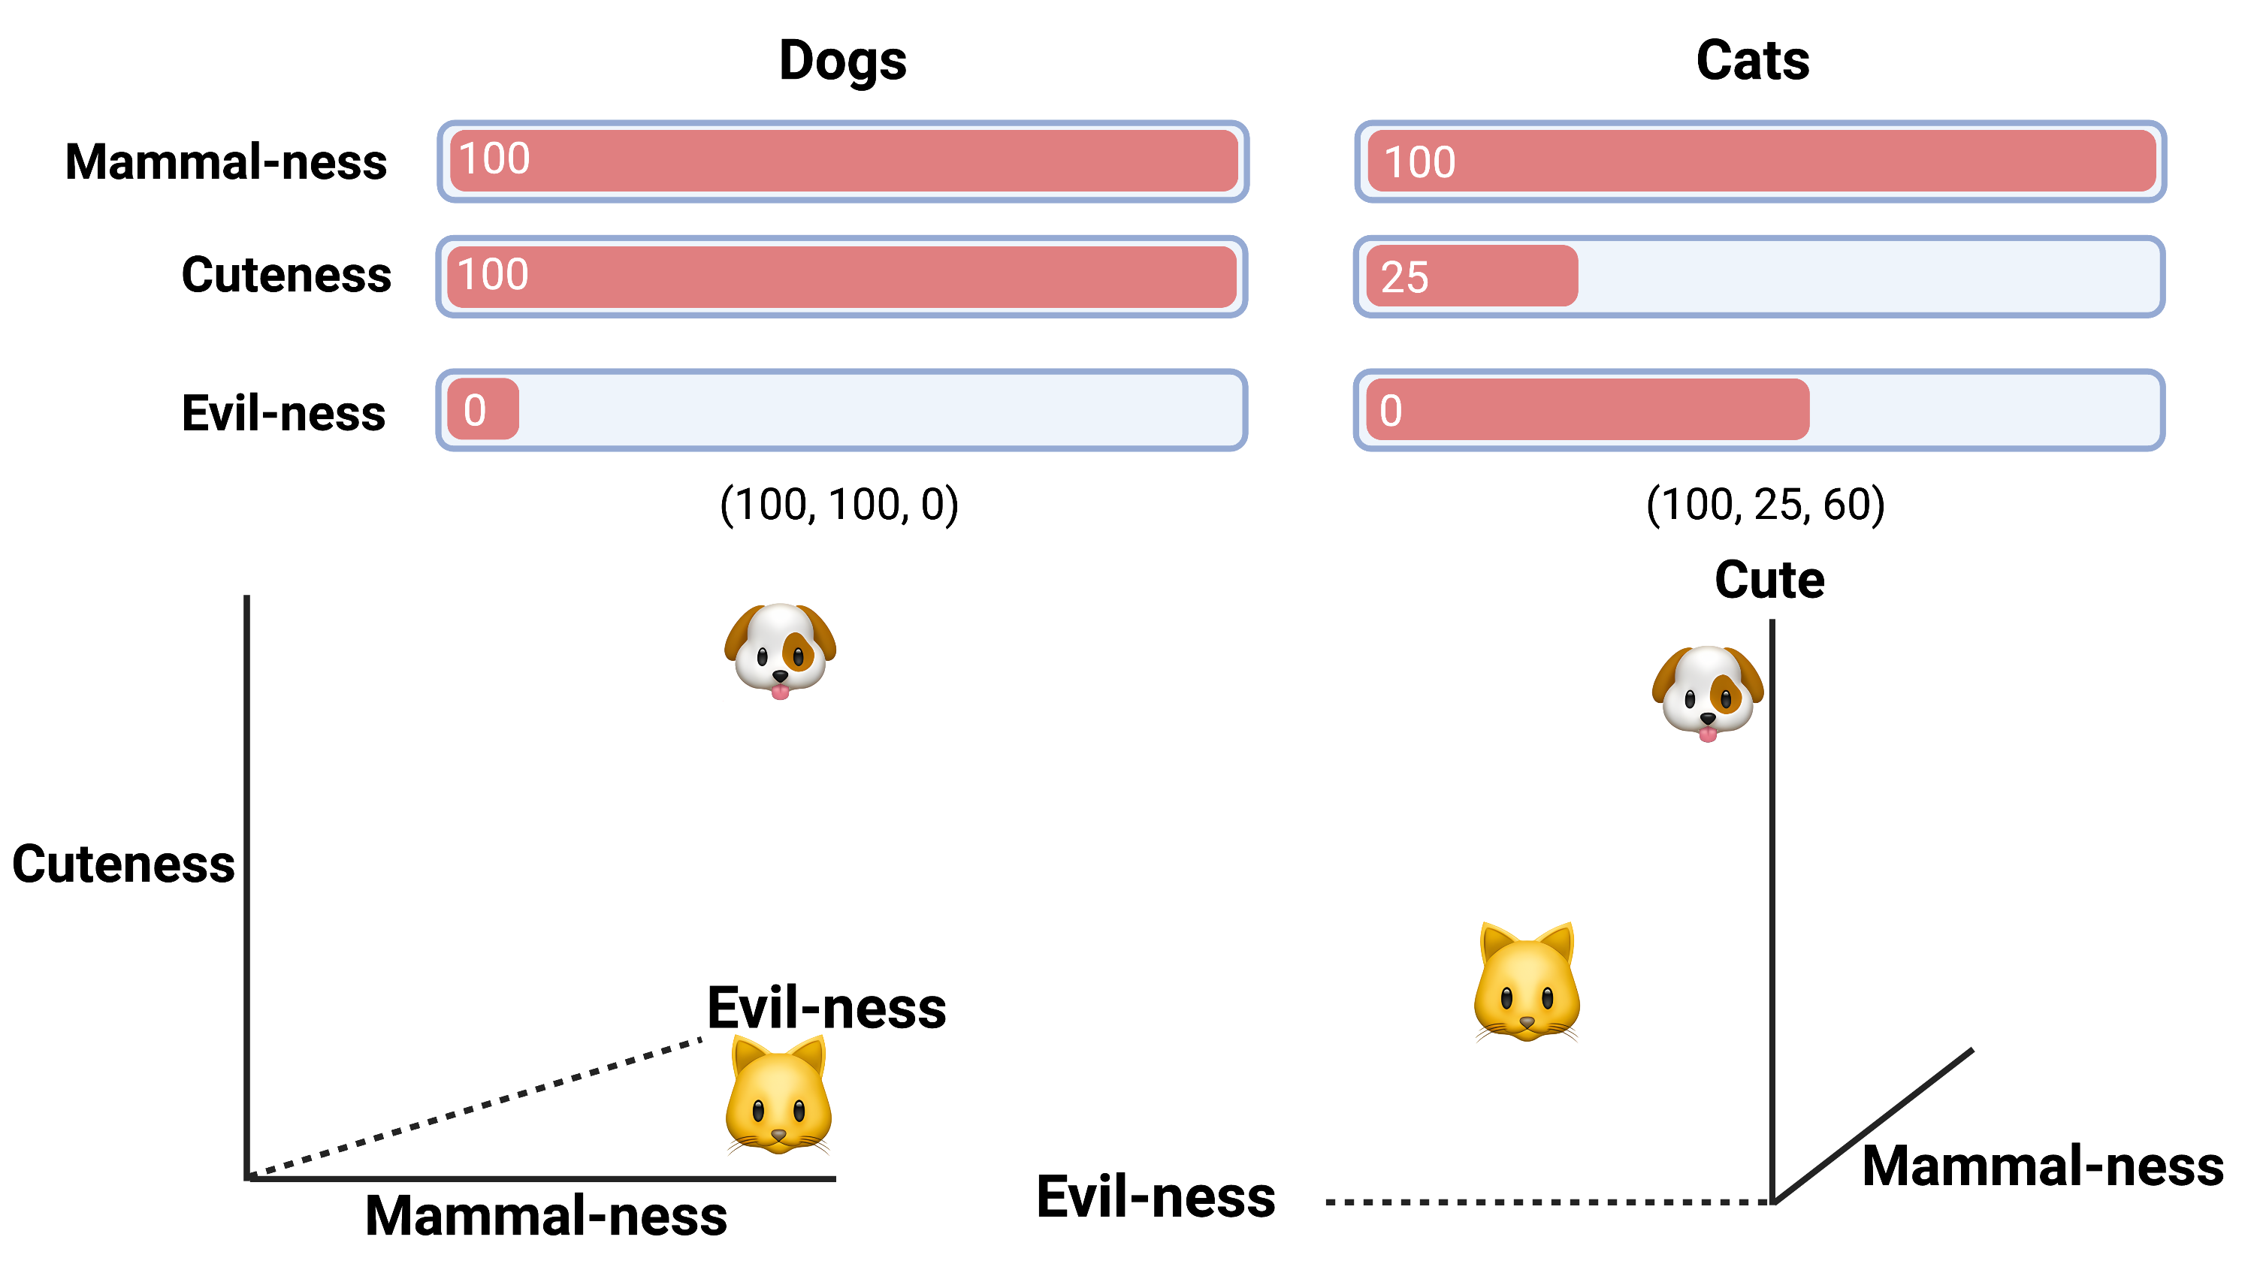

Slide 5


Slide 8
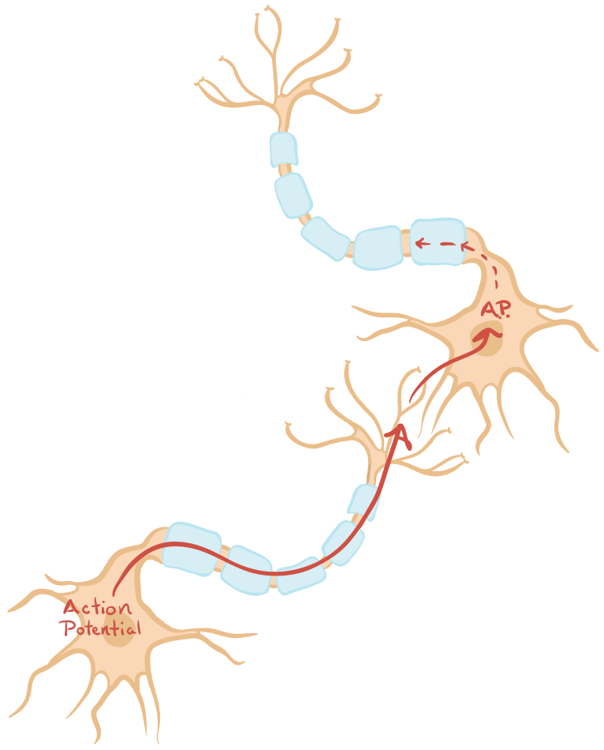
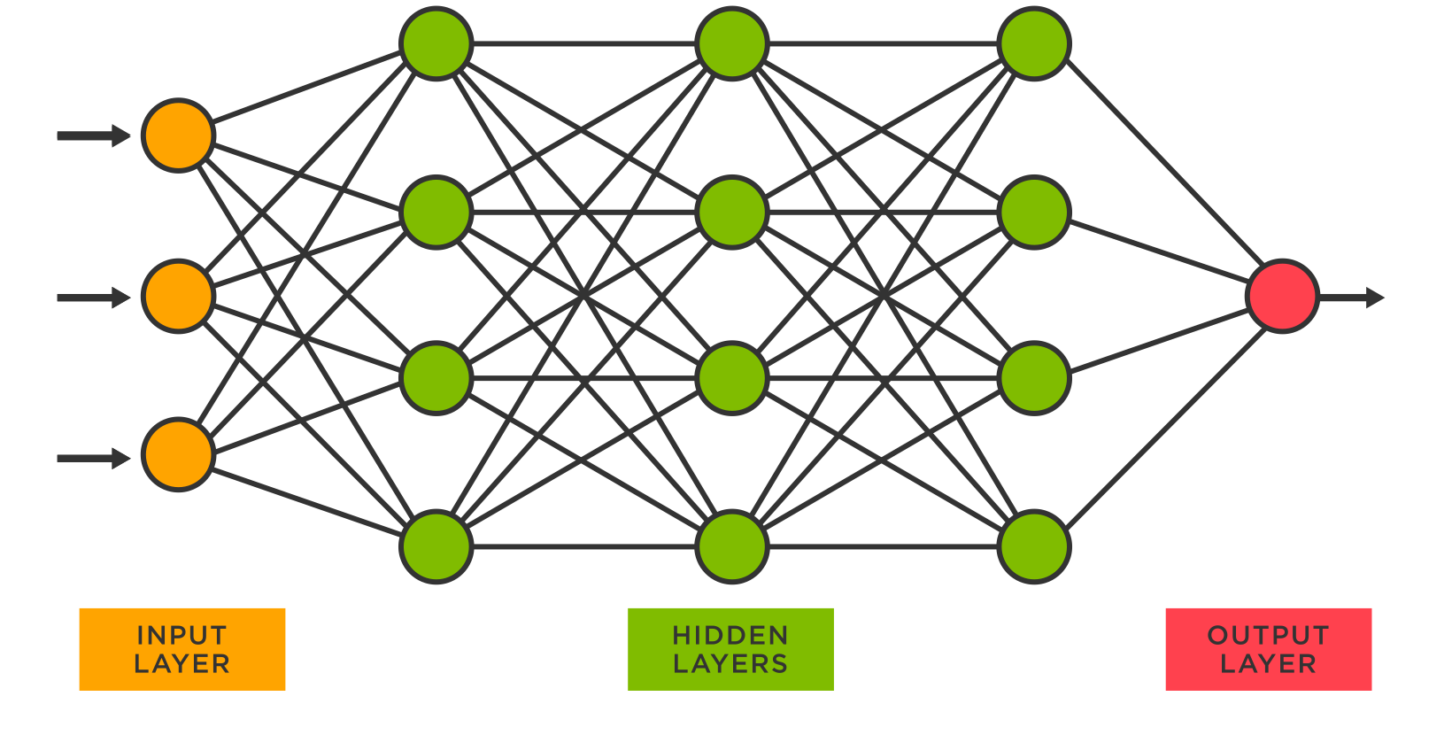
Neural Networks

Slide 9
Task: Next Word Prediction
Mitochondria is the ...

Slide 10
Task: Next Word Prediction
Mitochondria is the ...
Powerhouse of the cell

Slide 11
Task: Next Word Prediction
Mitochondria is the ...
Powerhouse of the cell
Organelle found in all human cells

Slide 12
3. Neural Networks: Backwards Pass
0.2863), (1.2307), (2.5174), (0.9929), (-3.7714), (-1.2208), (0.0851), (-0.2373), (-2.4234), (1.7426), (-0.1505), (-0.8594), (4.8210), (-0.8130), (2.5217), (0.6487), (0.4648), (-1.4481), (-0.9089), (0.0548), (2.3526), (-0.3699), (1.1465), (0.5105), (2.3646), (-0.7747), (4.9055), (-1.3934), (-1.8953), (-1.3712), (2.4309), (5.2719), (2.0144), (1.8627), (1.4278), (-2.4139), (-1.0946), (-0.3024), (-4.2780), (-0.3049), (0.6957), (0.4319), (1.8508), (-1.8022), (-0.3920), (-2.1429), (0.2166), (2.2102), (3.7859), (1.0934), (-0.3237), (-0.8731), (-2.2672), (0.1332), (1.9536), (2.7384), (1.3187), (4.8000), (-3.3562), (-1.1232), (-0.7049), (0.4410), (-2.6155), (0.0512), (1.9210), (2.6836), (-0.4785), (-4.0392), (-1.9838), (-1.3981), (0.3803), (-0.4307), (-1.9314), (0.7149), (0.7923), (-5.1067), (2.1485), (0.1936), (0.5231), (5.1777), (-1.1731), (2.1841), (2.2894), (-1.0185), (-0.5580), (-2.9298), (-2.5891), (-1.2704),
(-0.8370), (-0.9963), (1.0568), (1.4176), (0.5535), (1.9373), (1.5074), (4.8390), (-2.9668), (-1.0379), (-0.3057), (-4.2351), (1.4341), (-1.4620), (-0.3731), (1.8755), (-1.4893), (-2.8241), (3.3332), (-0.0906), (1.8898), (0.8625), (-1.7802), (0.5090), (4.2222), (-2.3364), (1.1773), (1.8600), (-0.3164), (0.2378), (-2.1901), (0.7255), (0.9425), (-1.8687), (-0.2551), (0.1737), (-1.6383), (1.0909), (0.9690), (-0.1866), (-0.4658), (-0.6676), (0.7904), (-1.1645), (-0.7734), (-3.5555), (-1.1131), (-1.0456), (0.4416), (1.2329), (1.4033), (1.1766), (-2.2999), (-0.4118), (-0.1187), (-0.1156), (0.3535), (-0.1656), (-0.3172), (0.1175), (-4.8242), (2.8076), (1.2973), (-1.1101), (0.8656), (-0.4163), (2.3488), (-4.3332), (0.2469), (-0.6439), (-1.4424), (0.1270), (1.7528), (-2.7184), (1.4846), (0.4549), (-2.4588), (2.0927), (0.1093), (1.3892), (-3.8110), (0.7903), (1.0432), (2.6847), (0.5939), (-0.1726), (-0.5155), (0.3859),
Powerhouse
Organelle
-

Slide 13
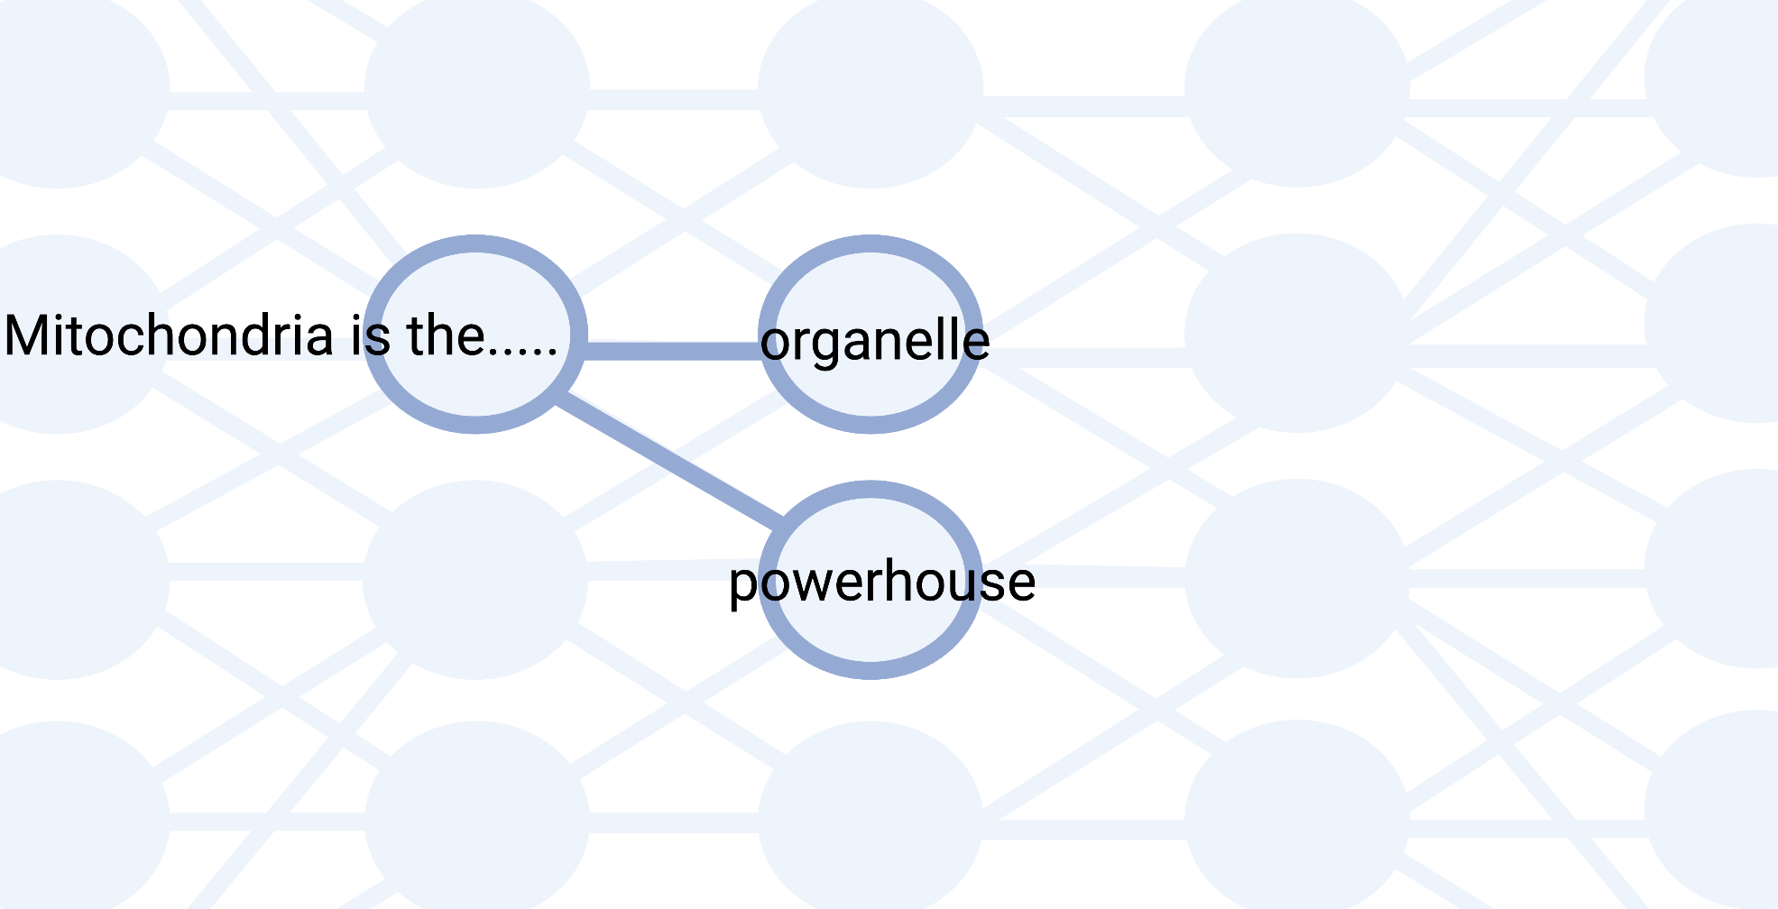
3. Neural Networks: Forward Pass

Slide 14
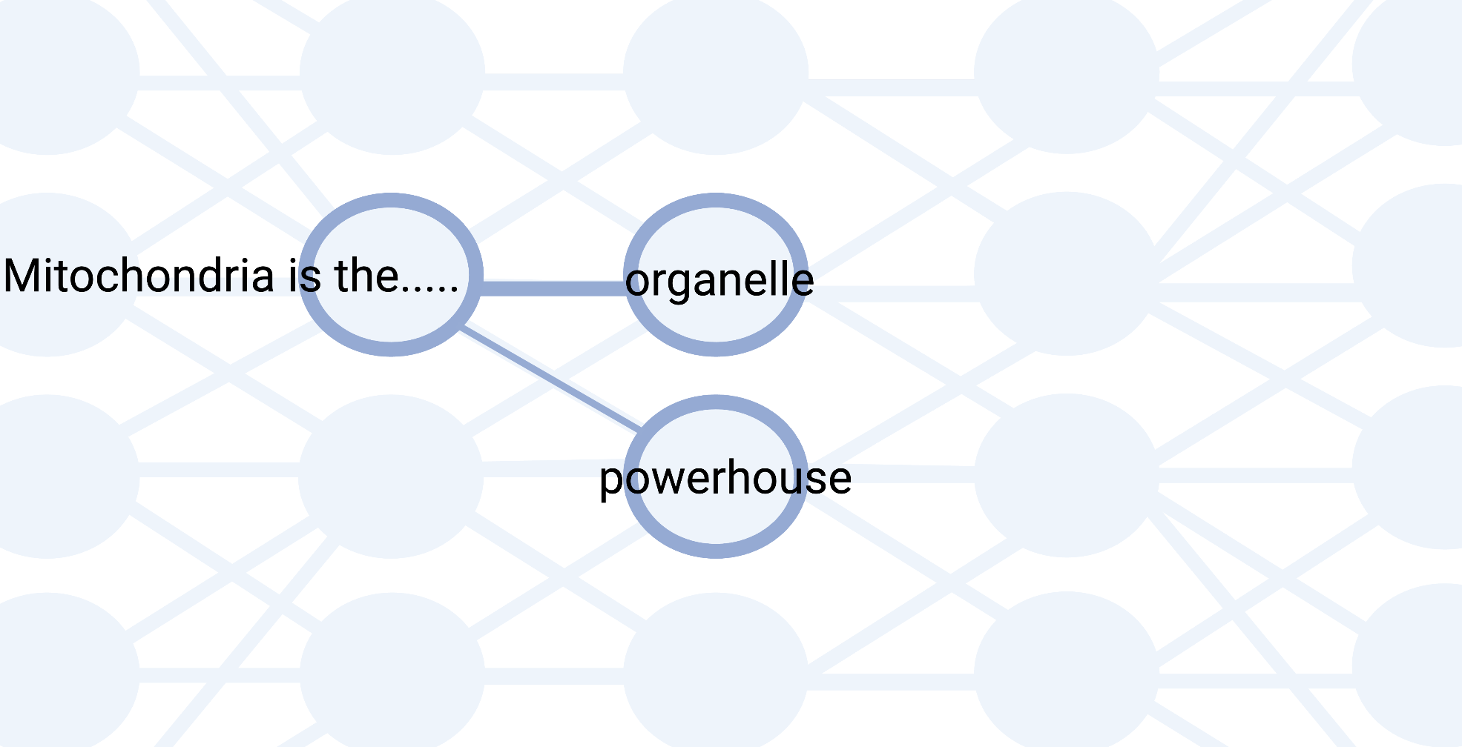
3. Neural Networks: Forward Pass

Slide 15
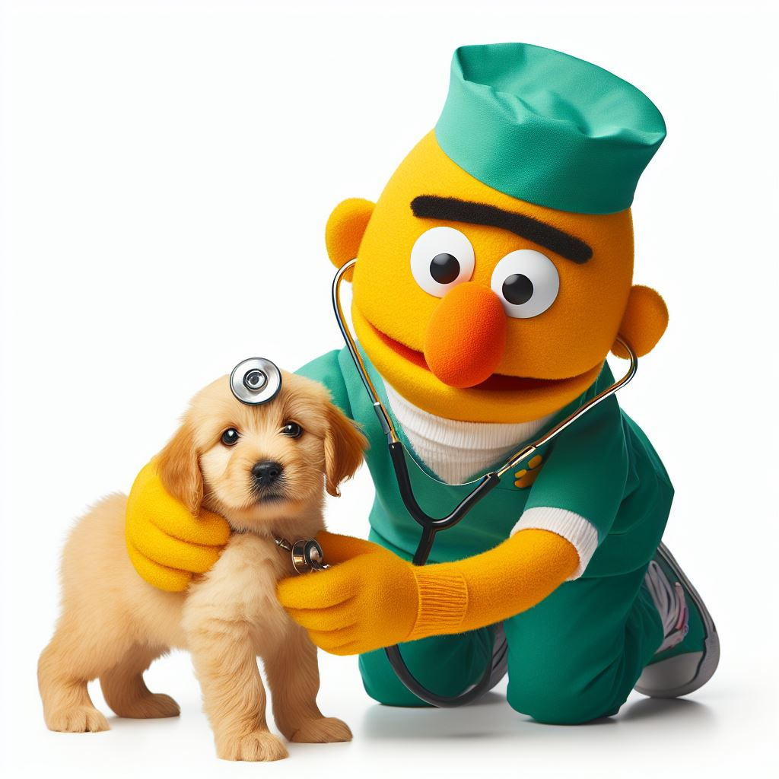
Can PetBERT Help Prevent the Next Apocalypse?
Sean Farrell
sean.farrell2@durham.ac.uk

Slide 16
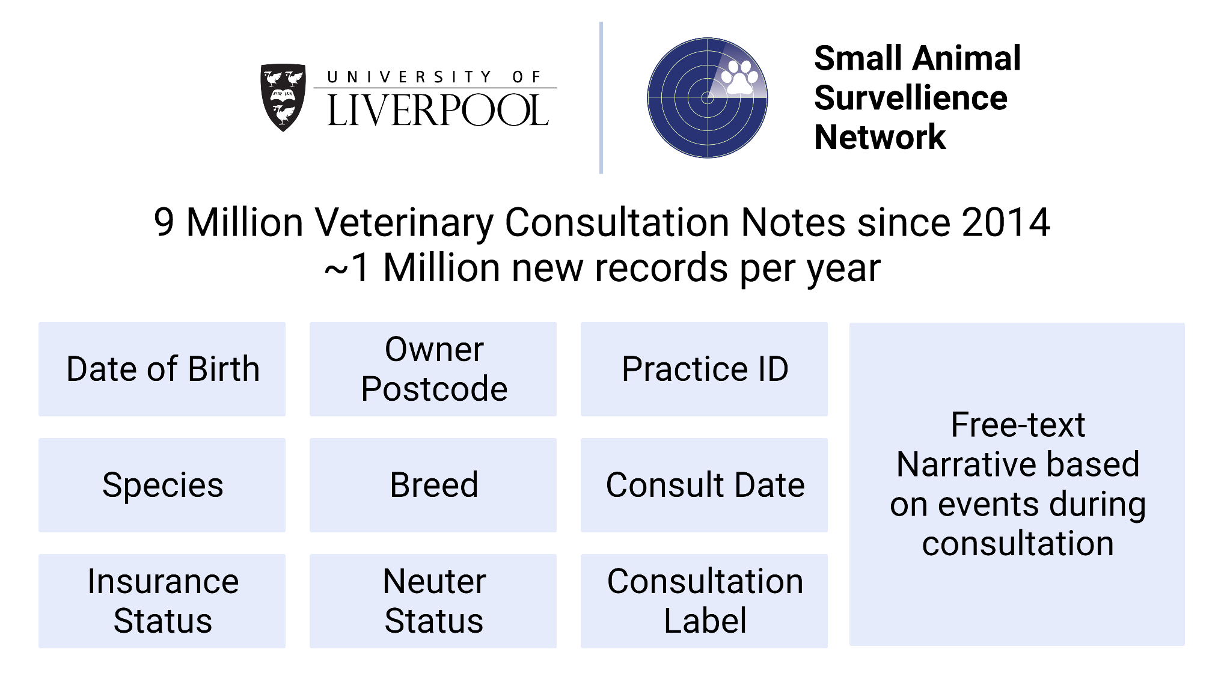
~9 million Veterinary Consultation Records since 2014
453 Sites across the UK
~1 million new records each year

Slide 17
~9 million Veterinary Consultation Records since 2014
453 Sites across the UK
~1 million new records each year

Slide 18
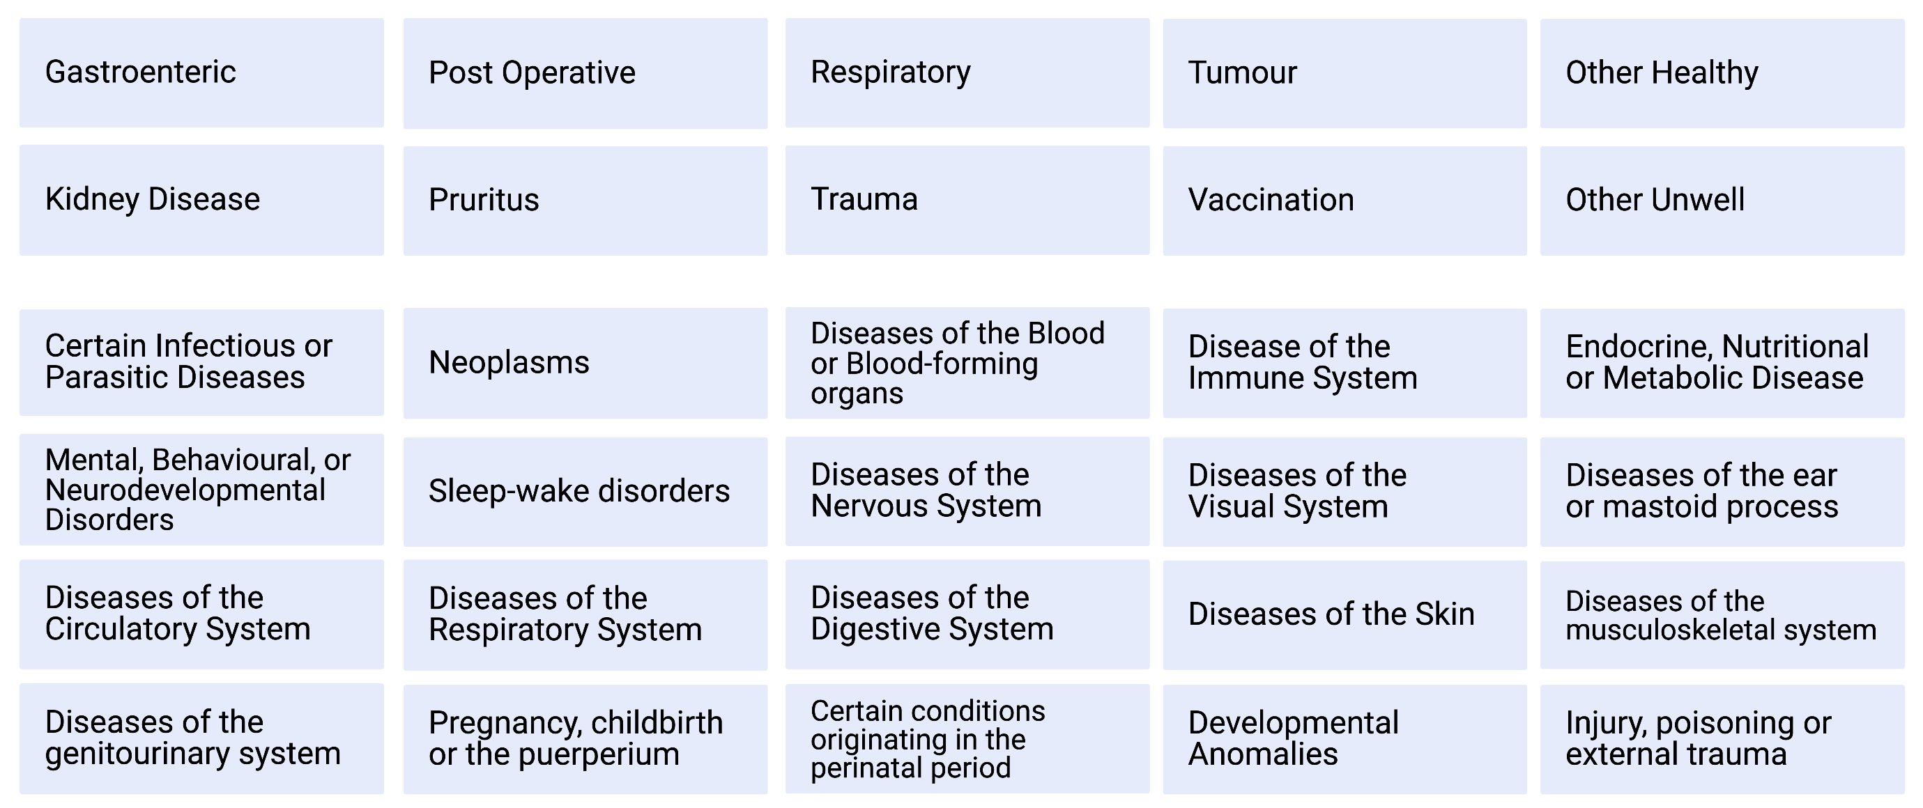
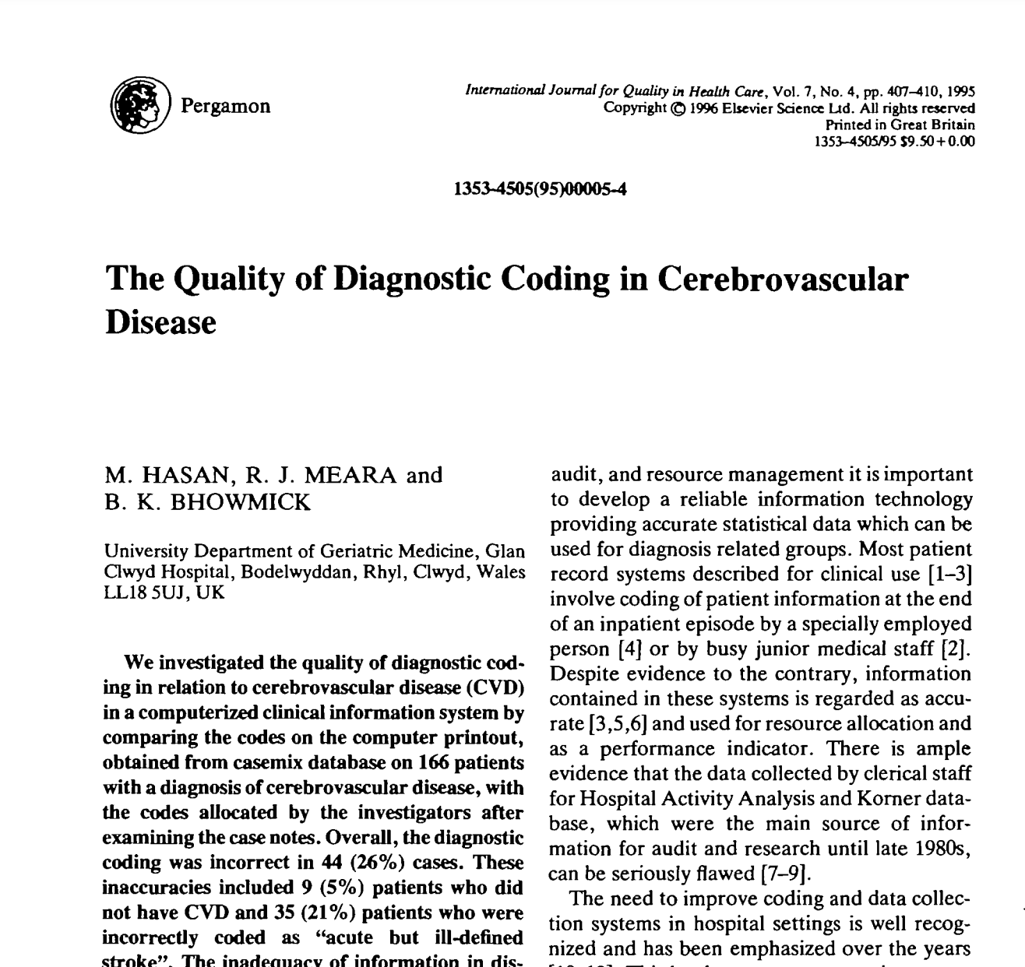
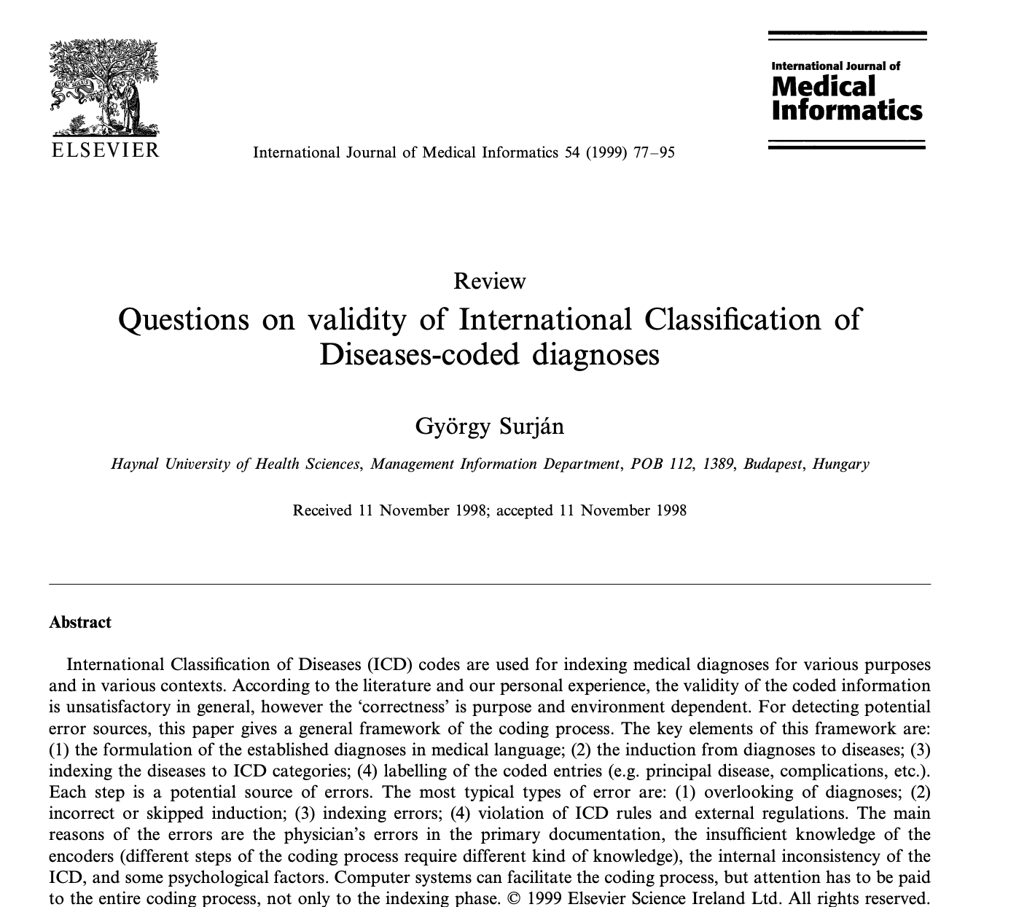
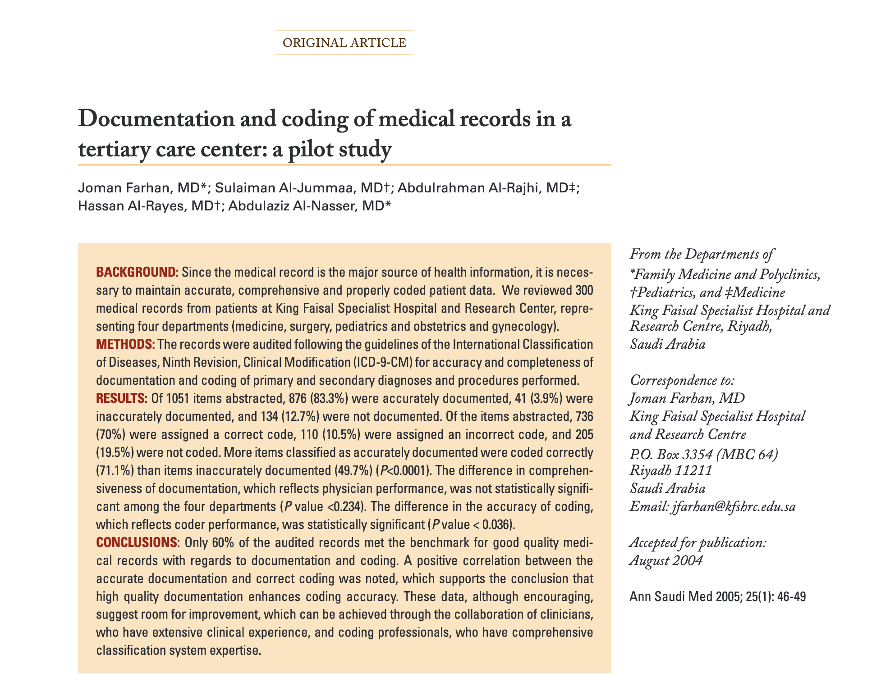
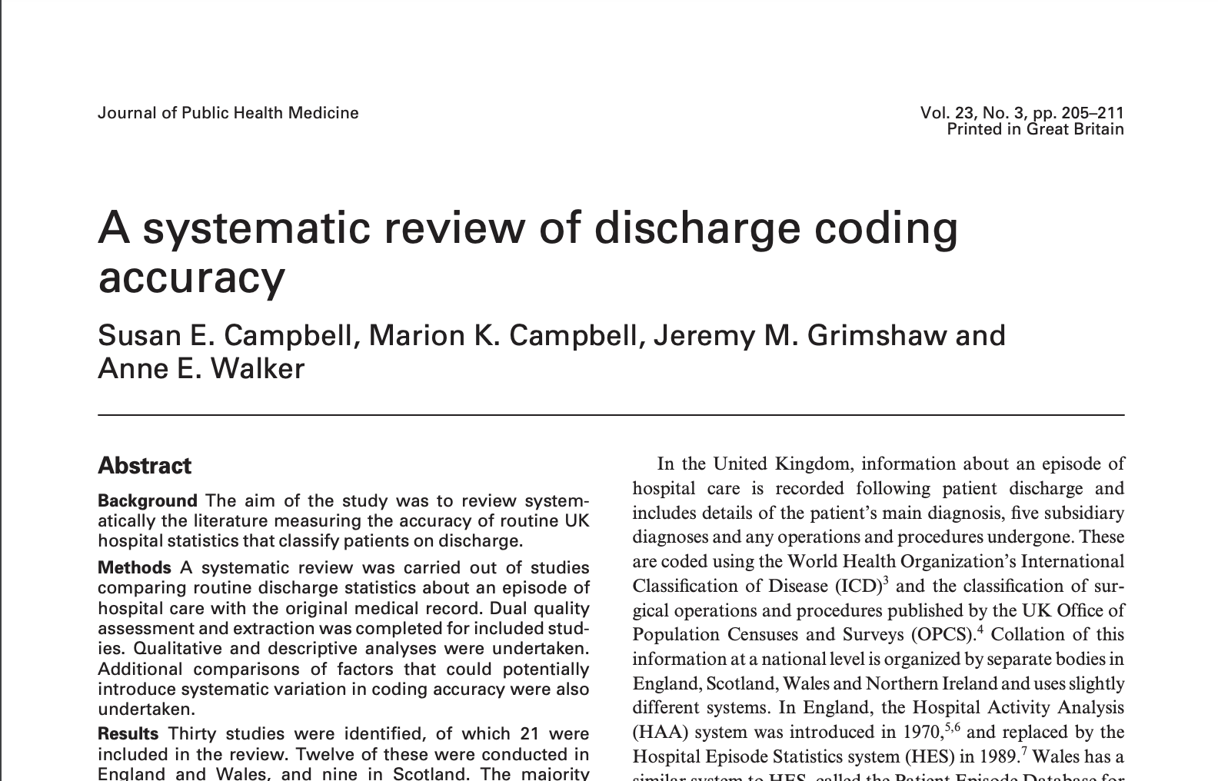
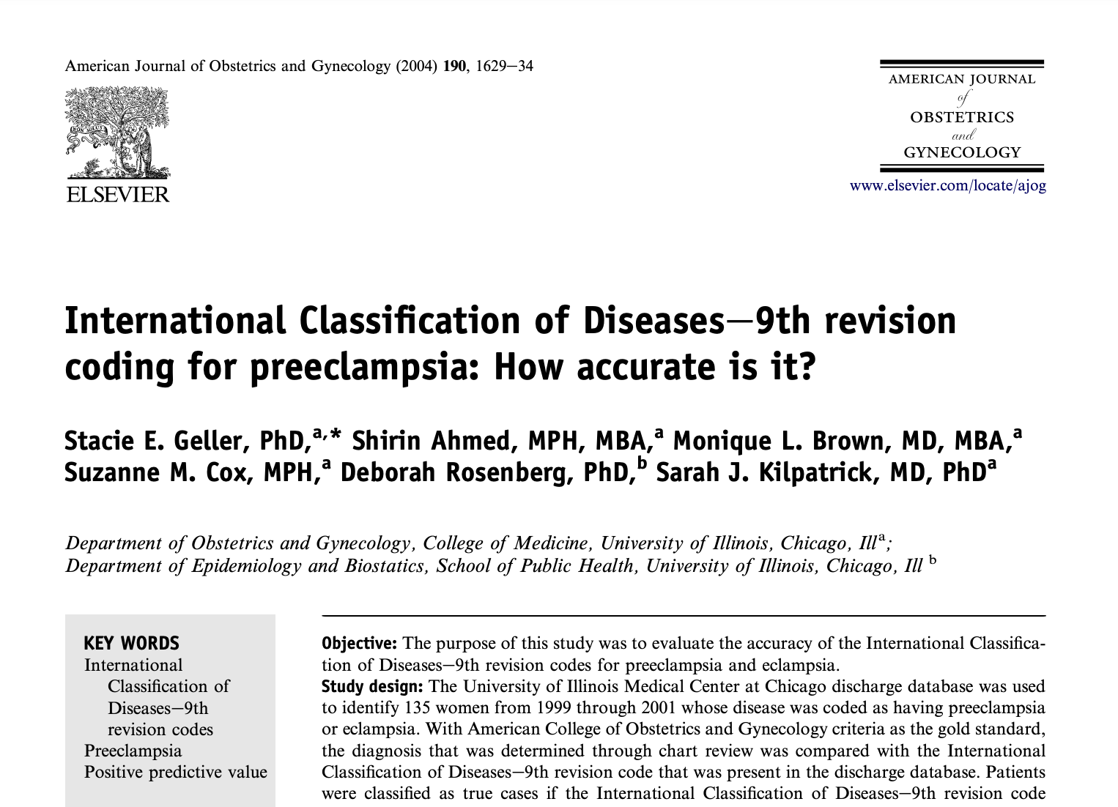
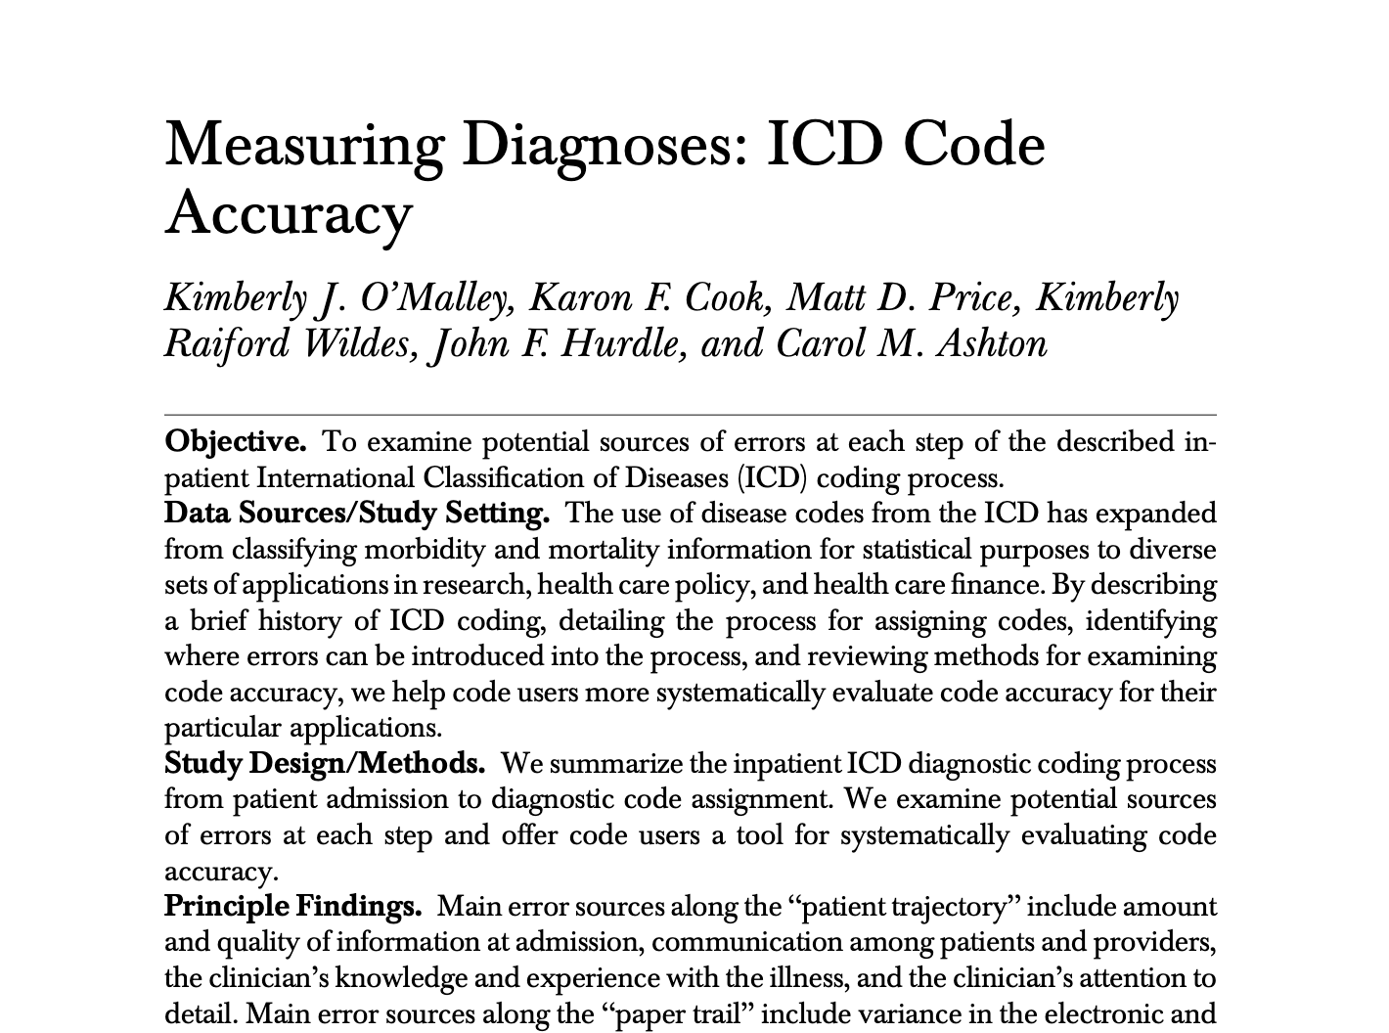
SAVSNET
Consultation Label
Notes:
SAVSNET Estimated Error Rate ~24%

Slide 19
Proposed WHO International Classification of Diseases 11
Syndromic Label

Slide 20
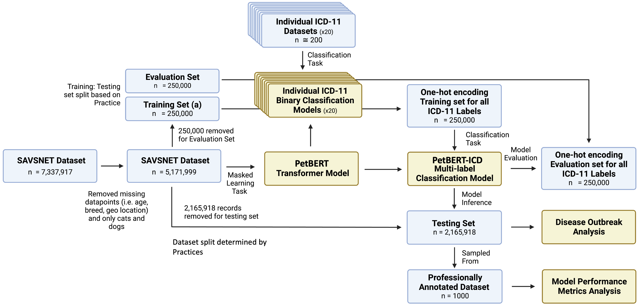

Slide 26
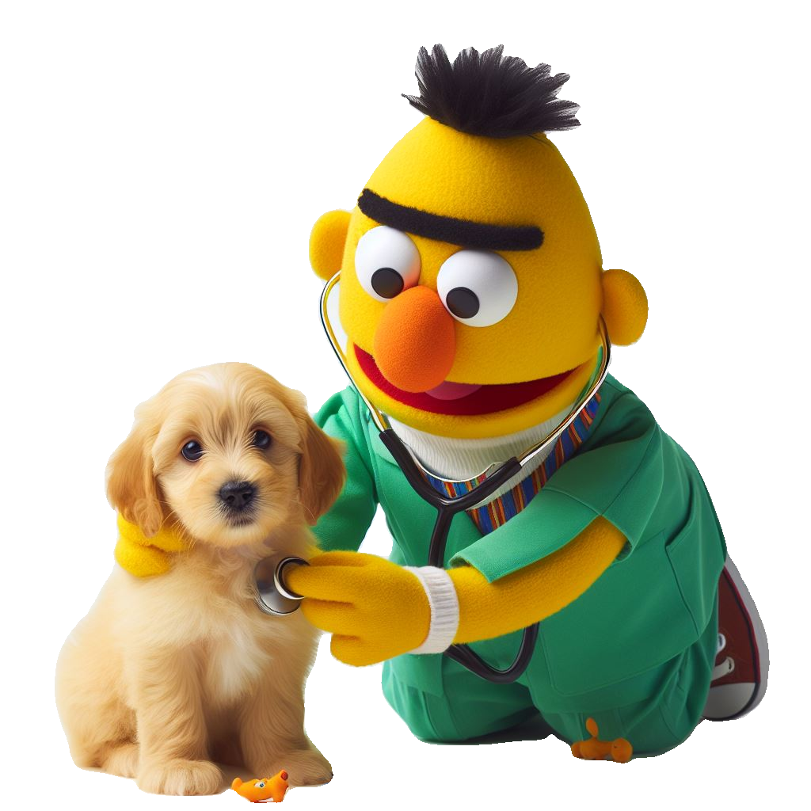
e.g. “Sam the Chihuahua presented with a cough, blood in the urine, and a skin rash”
Clinician-assigned Consultation Label
or
or
or
ICD-11 PetBERT Label
and
and

Slide 27
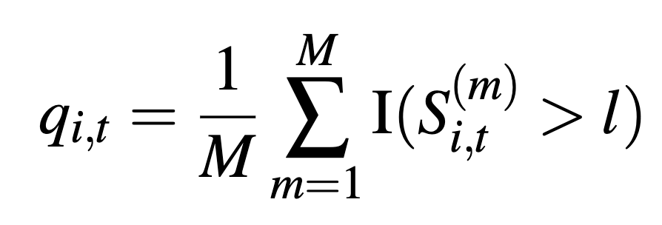
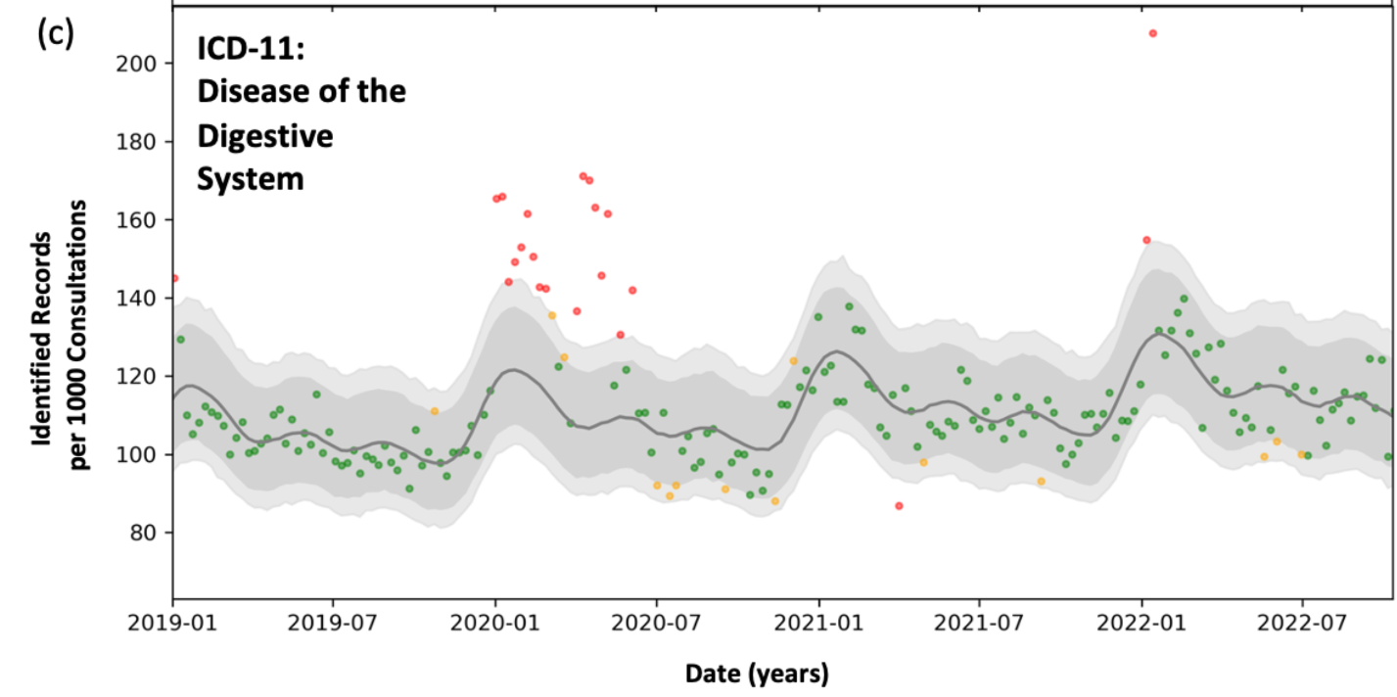
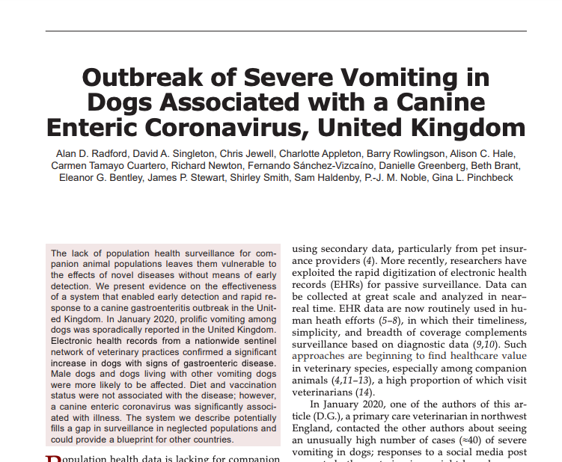
1 dot = 1 week
Outbreak of Severe Vomiting in Dogs Associated with a Canine Enteric Coronavirus, United Kingdom
Predicted
Prevalence
95% CI
99% CI
Possible Outbreak:
Two consecutive weeks where the red points exceeds the 99% confidence interval

Slide 28
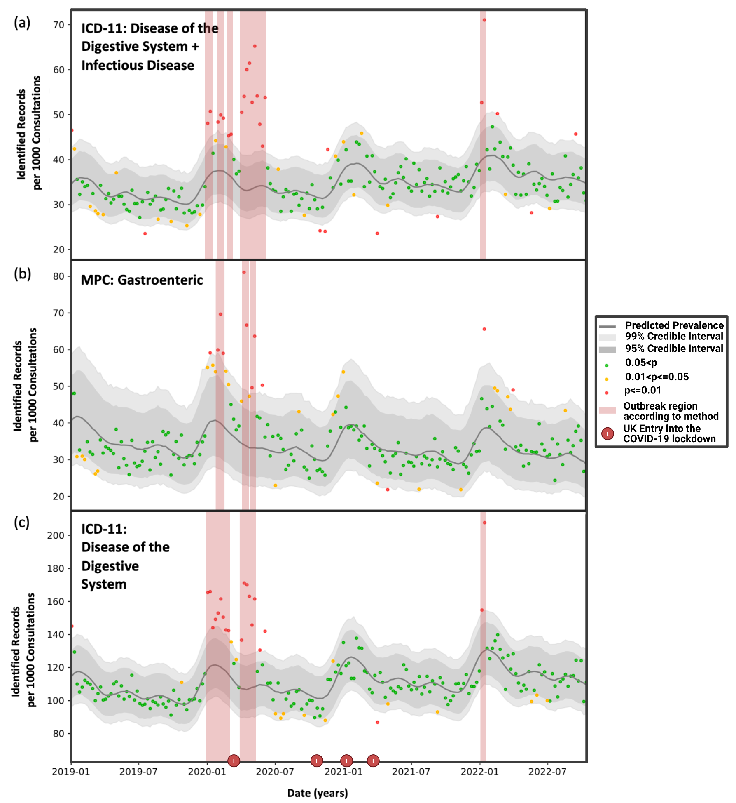
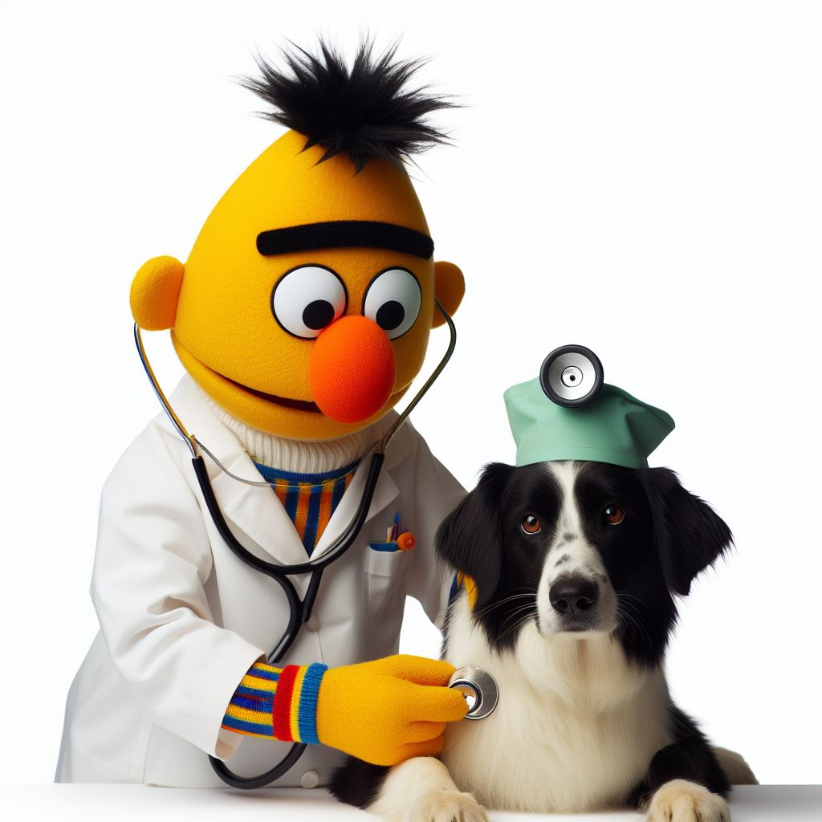
Clinician Label

Slide 29
Clinician Label
3 weeks!
PetBERT Label

Slide 30
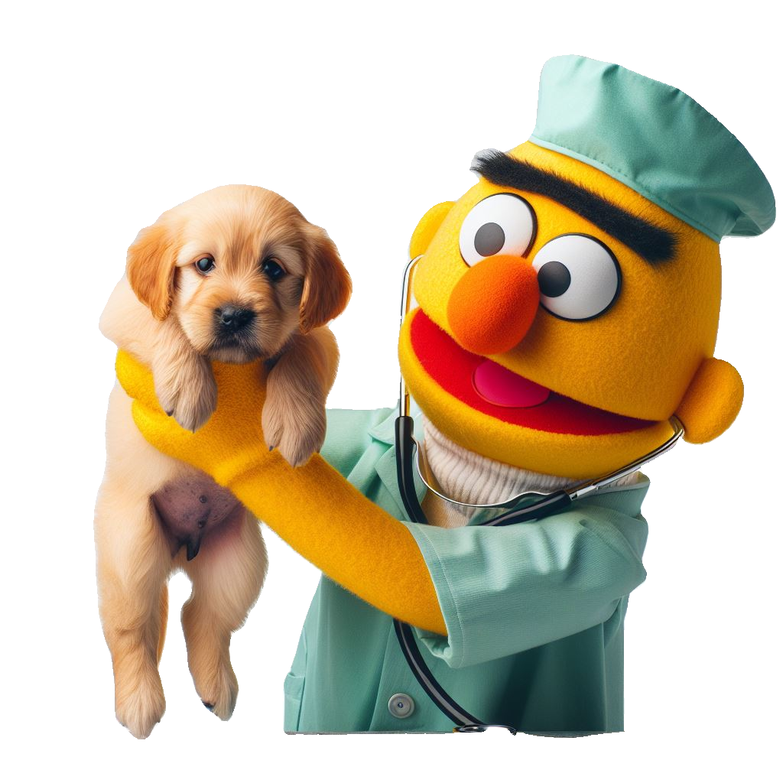
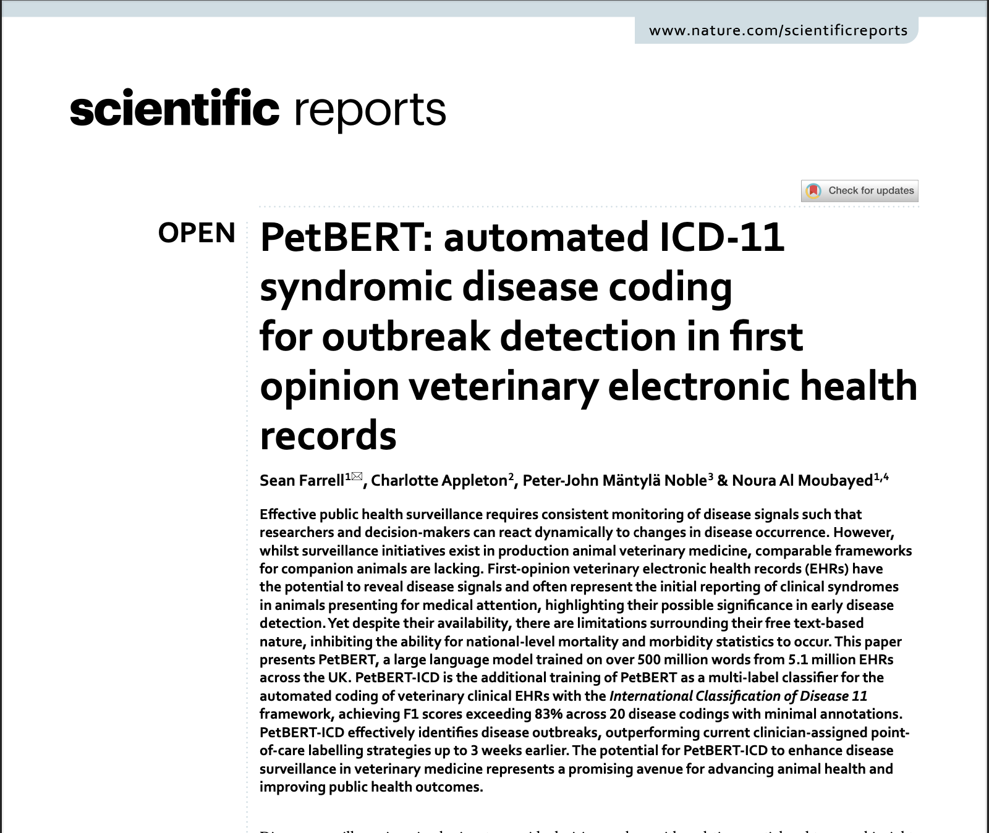
Thanks!
Sean Farrell
sean.farrell2@durham.ac.uk

